Slide 1

CSC496: Deep learning in computer vision Prof. Bei Xiao
Lecture 8: Temporal Processing

Slide 2
Lecture Forecast
Today (September 26): FT Python demo. Temporal processing, spatial-temporal gaussians, Very important to understand CNN.
Monday (September 30th) : Multiscale Pyramids. Quiz 2.
Thursday (October 3): Introduction to Machine learning: Linear models.
Monday (October 7th): Supervised learning.
Thursday (October 10th): Neural networks
Monday (October 14th): Tensorflow tutorials
Thursday (October 18th): Back propagation

Slide 3
Take-home reading
SignalProcessing.pdf up to page 46

Slide 4
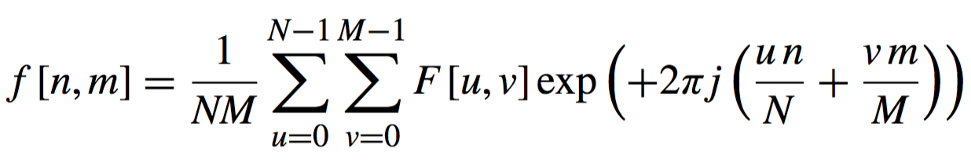
The inverse Discrete Fourier transform
How does summing waves ends up giving back a picture?

Slide 5
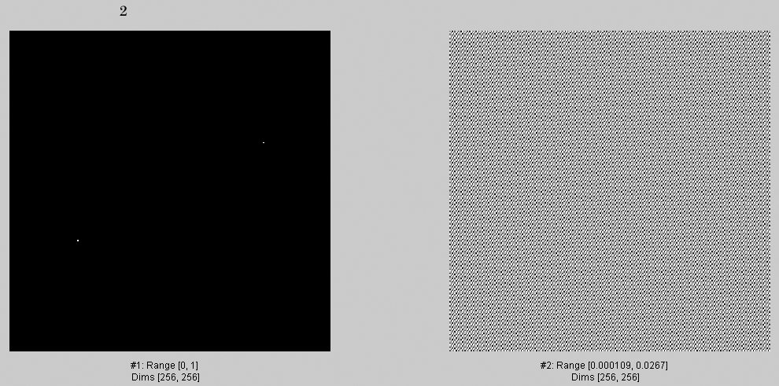
2

Slide 6
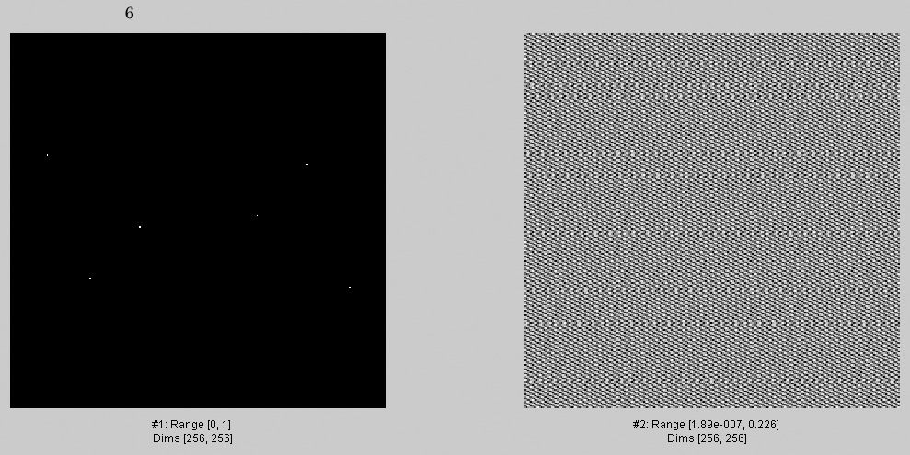
6

Slide 7
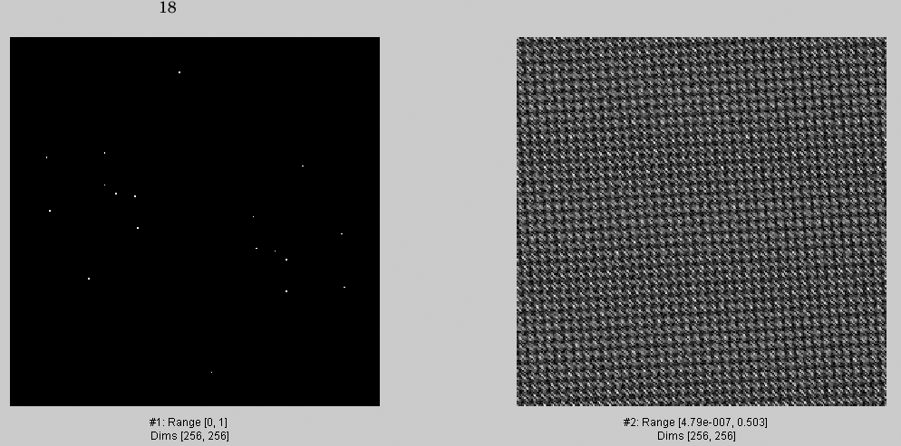
18

Slide 8
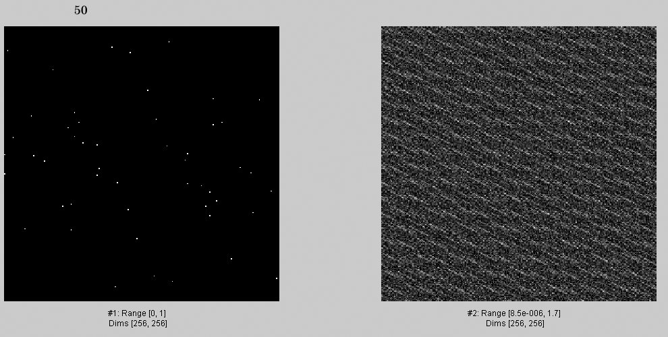
50

Slide 9
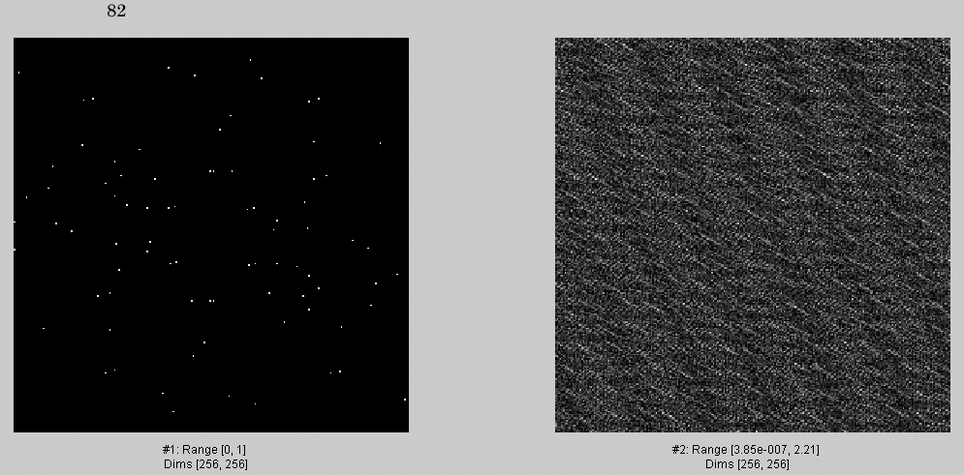
82

Slide 10
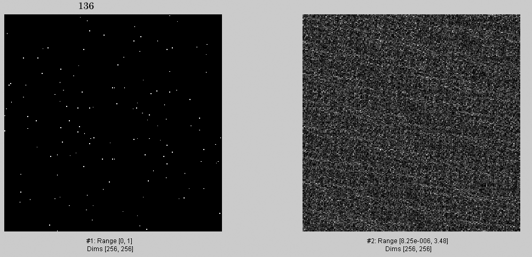
136

Slide 11
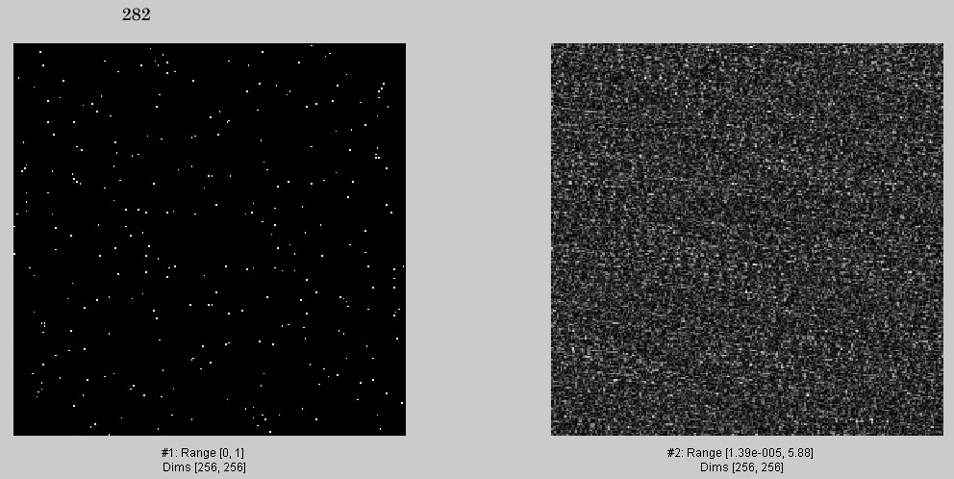
282

Slide 12
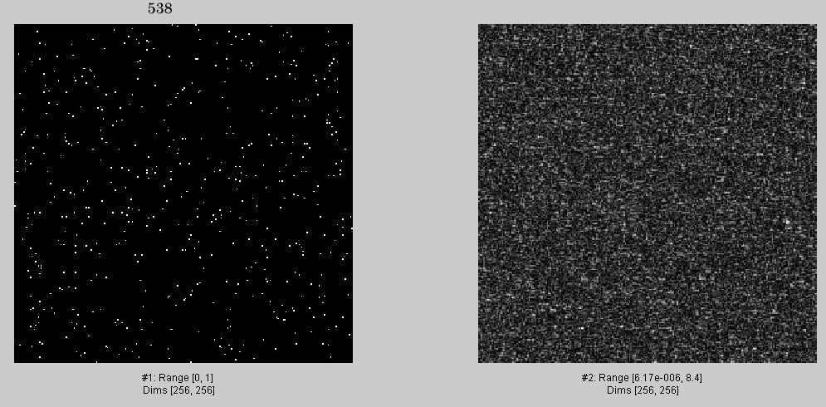
538

Slide 13
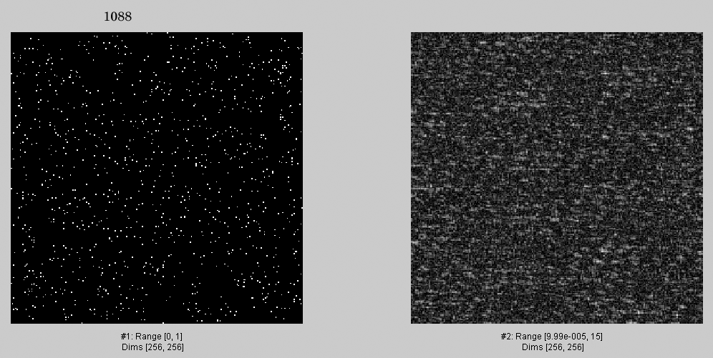
1088

Slide 14
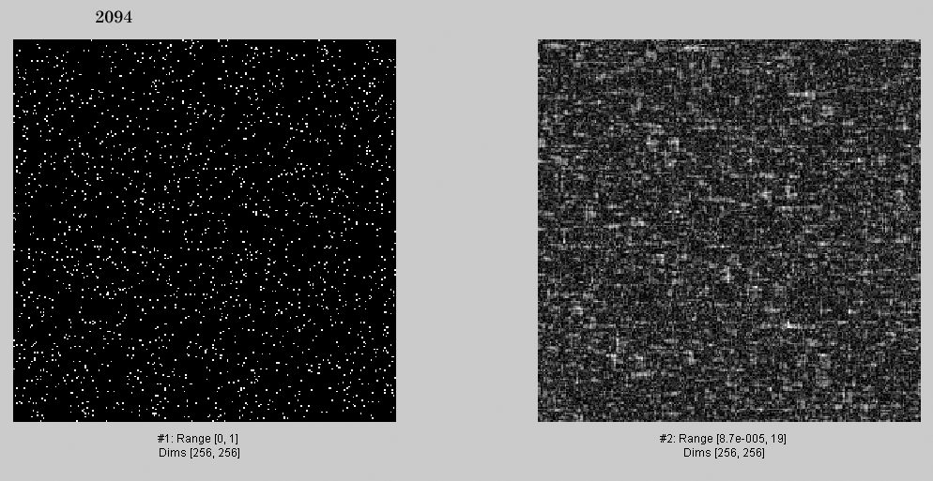
2094

Slide 15
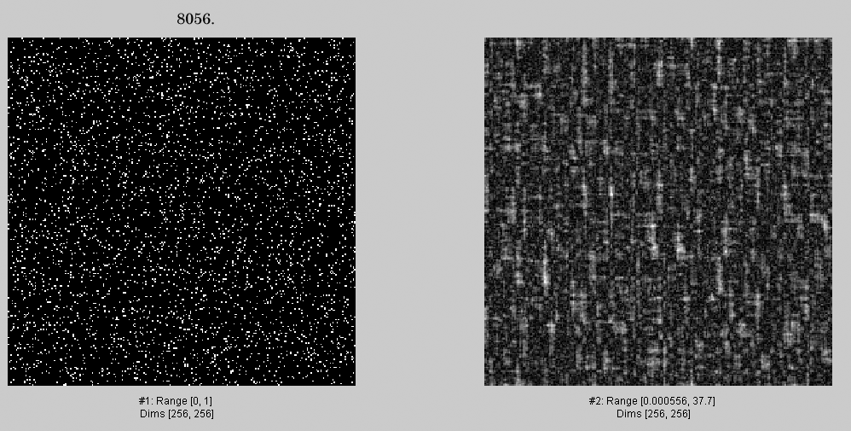
4052.
4052

Slide 16
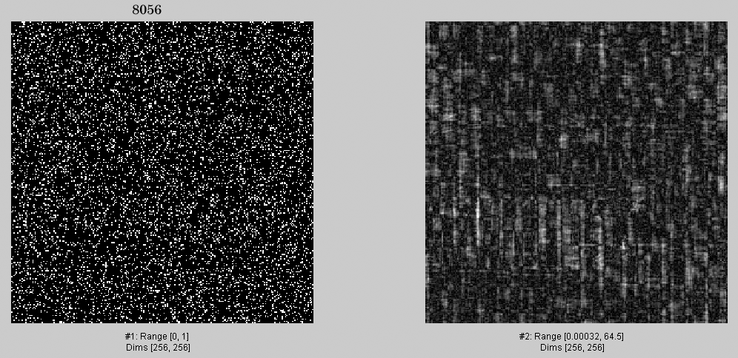
8056.

Slide 17
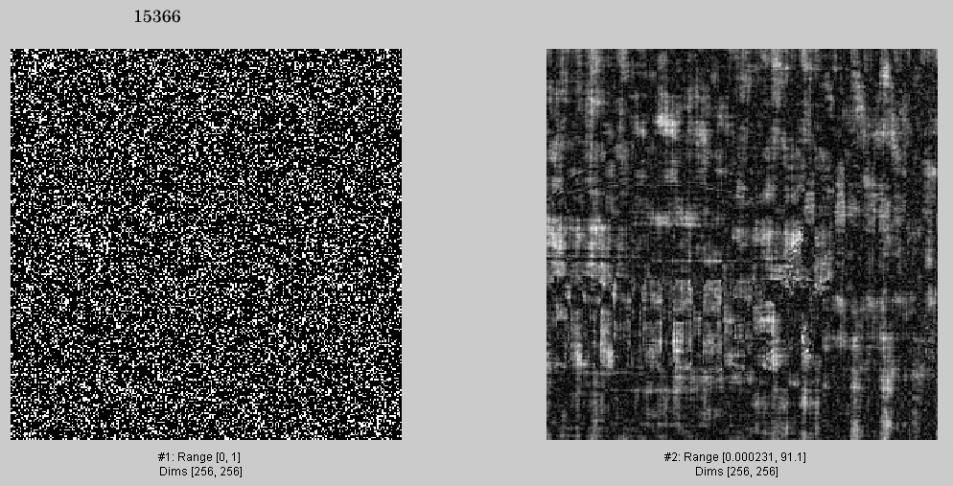
15366

Slide 18
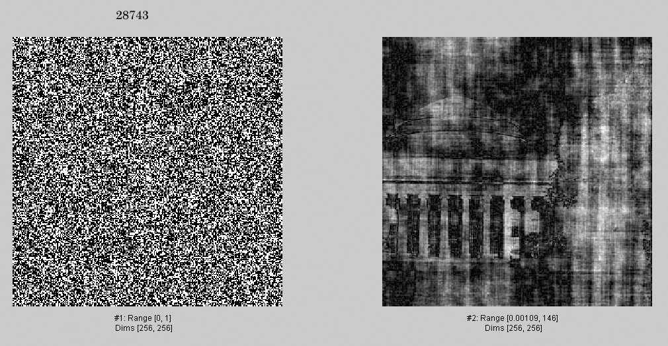
28743

Slide 19
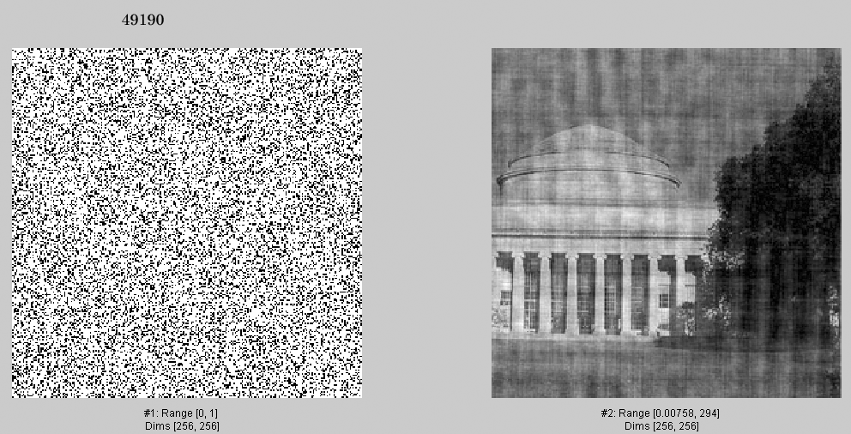
49190.

Slide 20
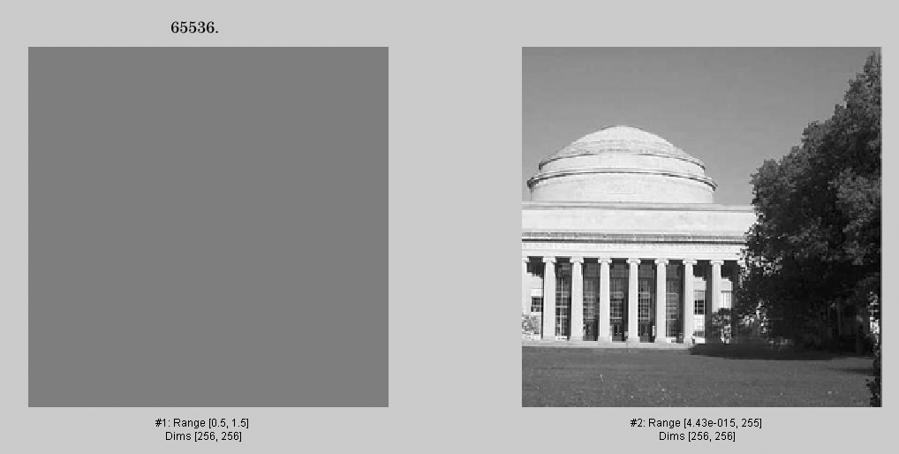
65536.

Slide 21
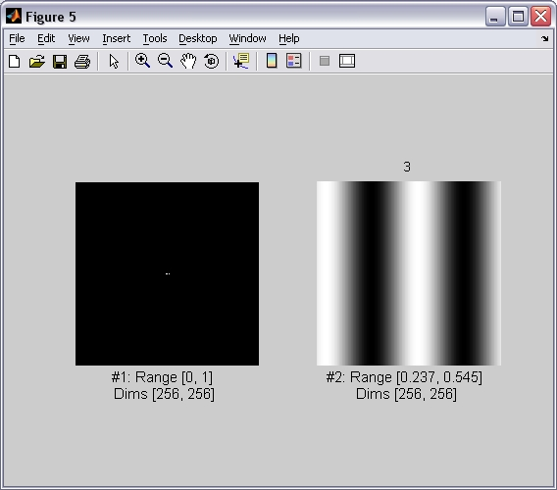
3
Now, an analogous sequence of images, but selecting Fourier components in descending order of magnitude.

Slide 22
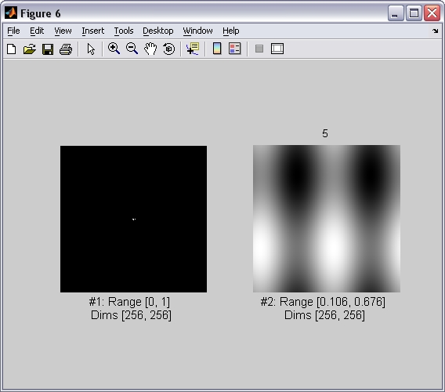
5

Slide 23
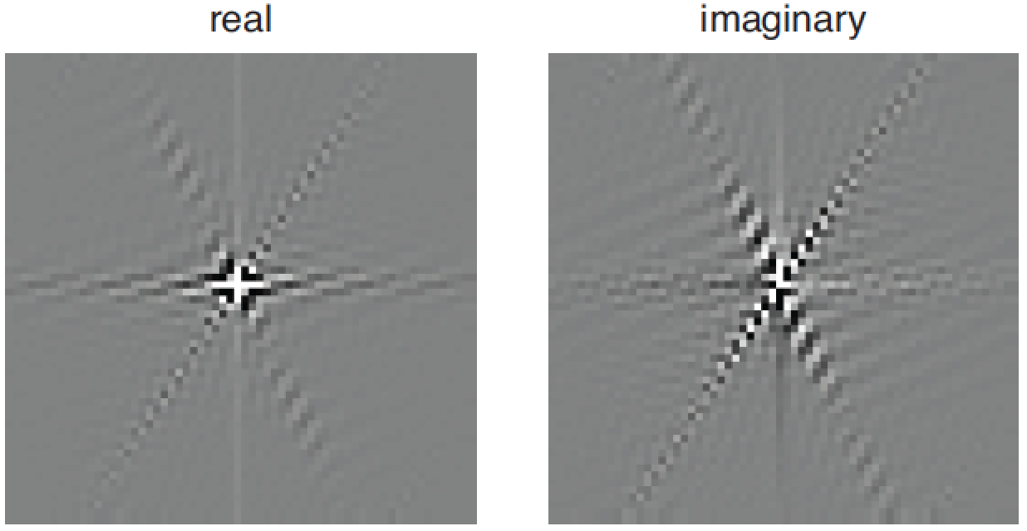
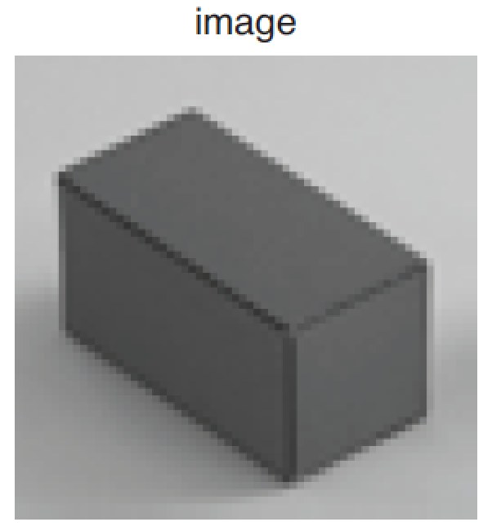
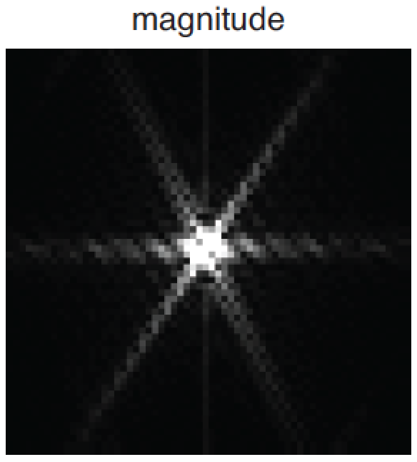
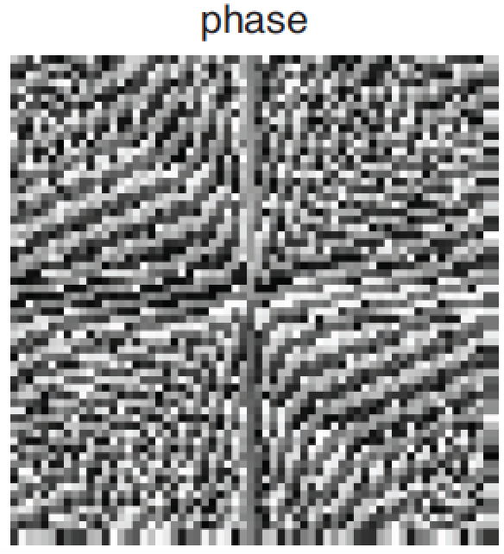
2D Discrete Fourier Transform

Slide 24
Phase and Magnitude
Curious fact
all natural images have about the same magnitude transform
hence, phase seems to matter, but magnitude largely doesn’t
Demonstration
Take two pictures, swap the phase transforms, compute the inverse - what does the result look like?

Slide 25
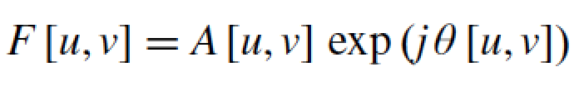

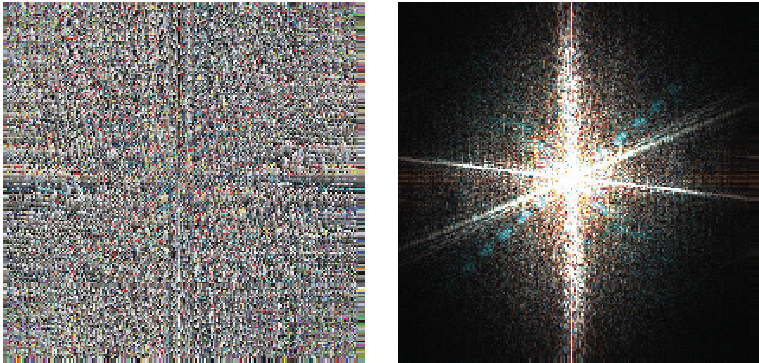


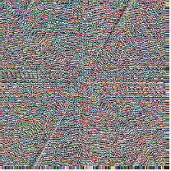
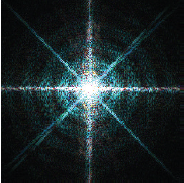
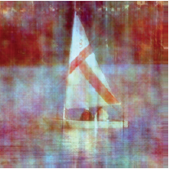
Phase and Magnitude
Each color channel is processed in the same way.

Slide 26
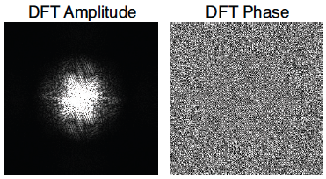

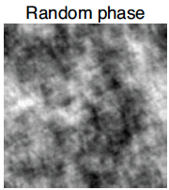
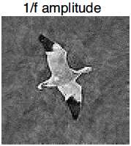
Phase and magnitude
Using random amplitude does not look good.

Slide 27
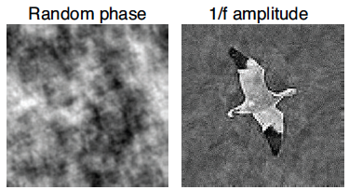
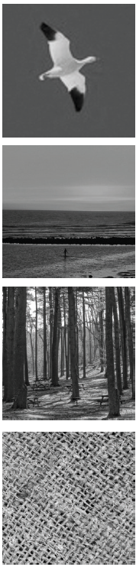
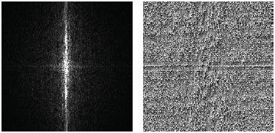
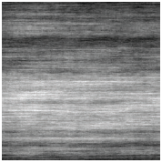
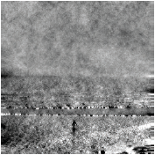
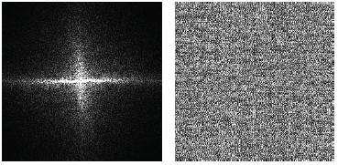
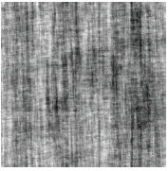
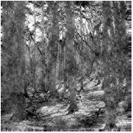
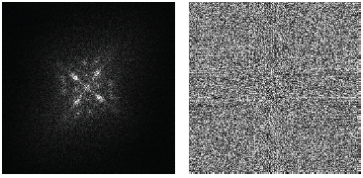
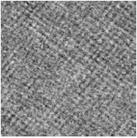
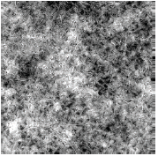
Does phase always win?

Slide 28
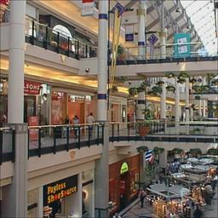
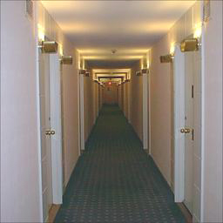

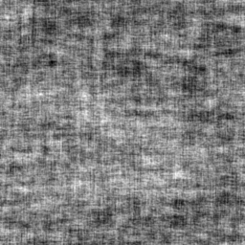
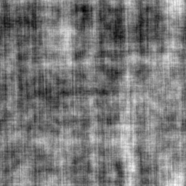
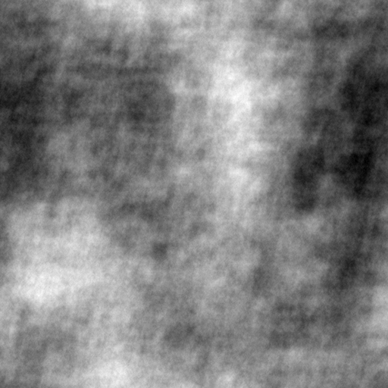
Randomizing the phase

Slide 29
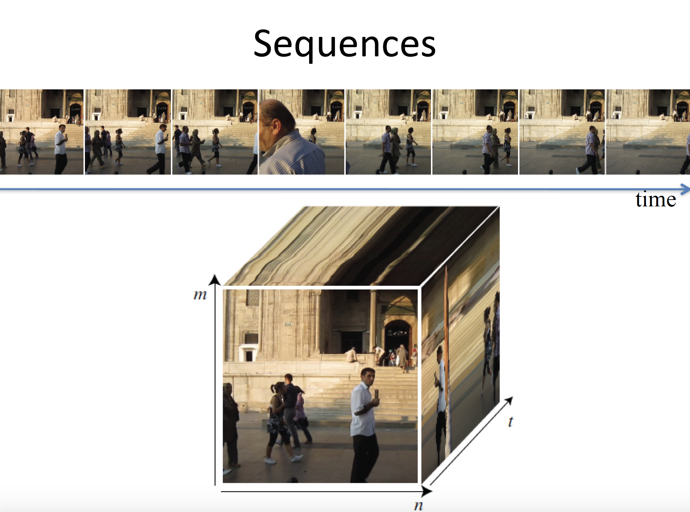

Slide 30
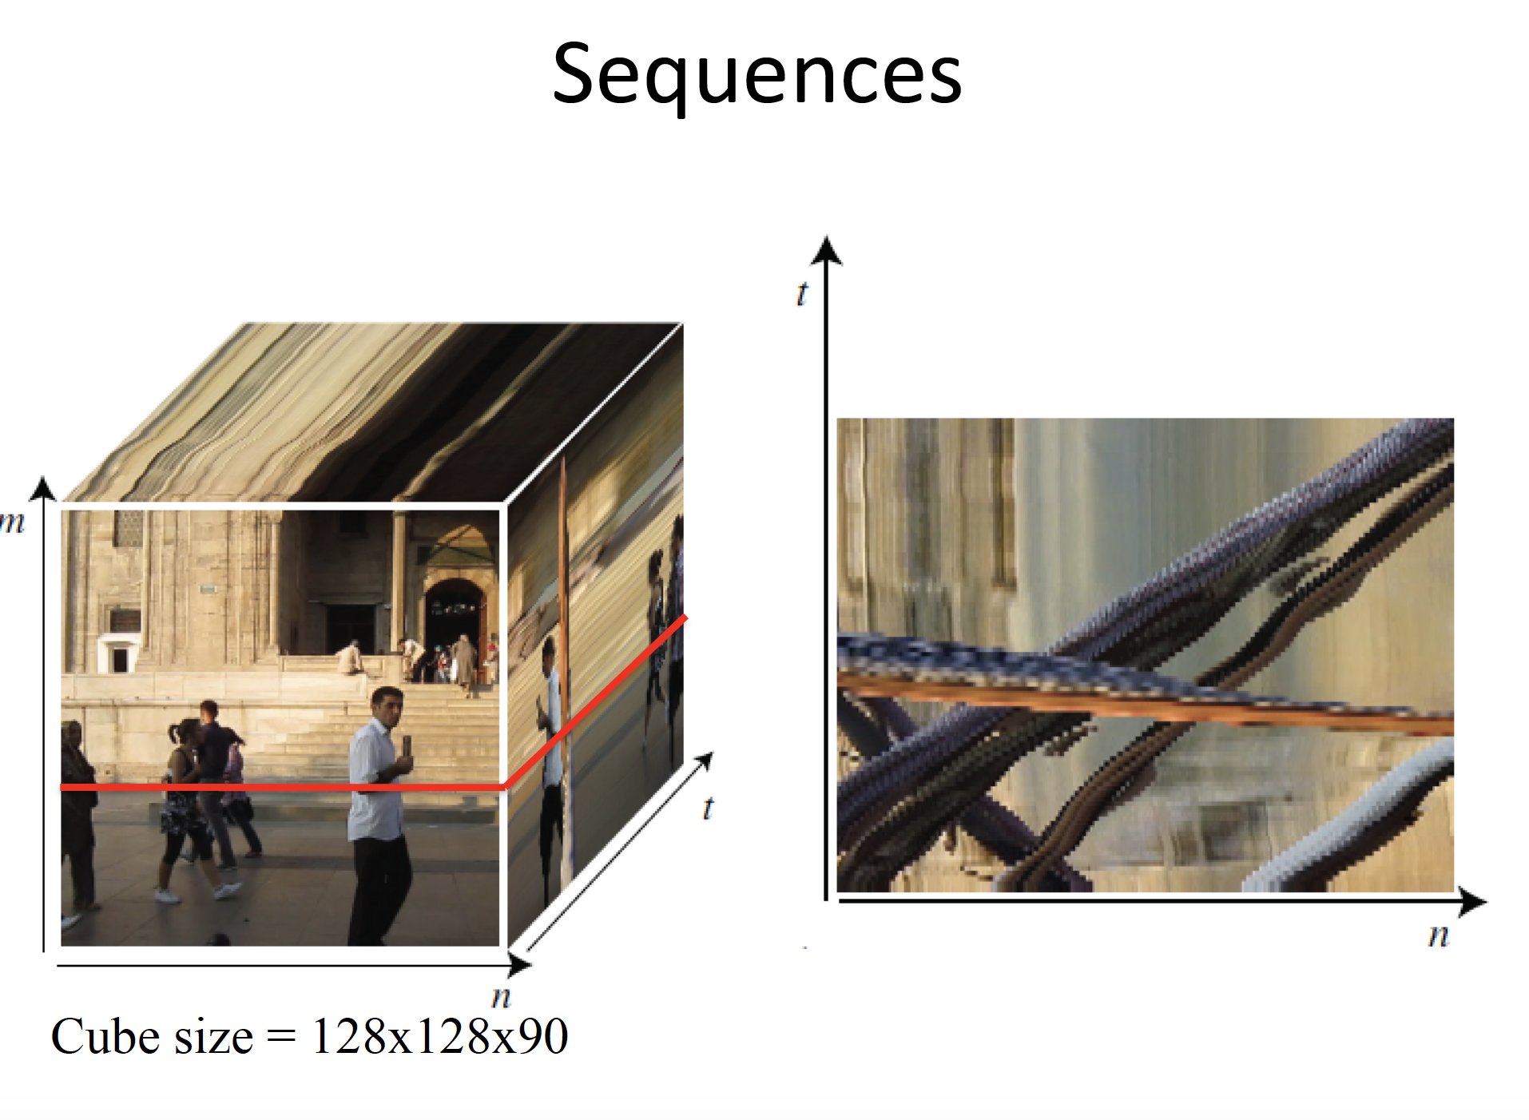

Slide 31
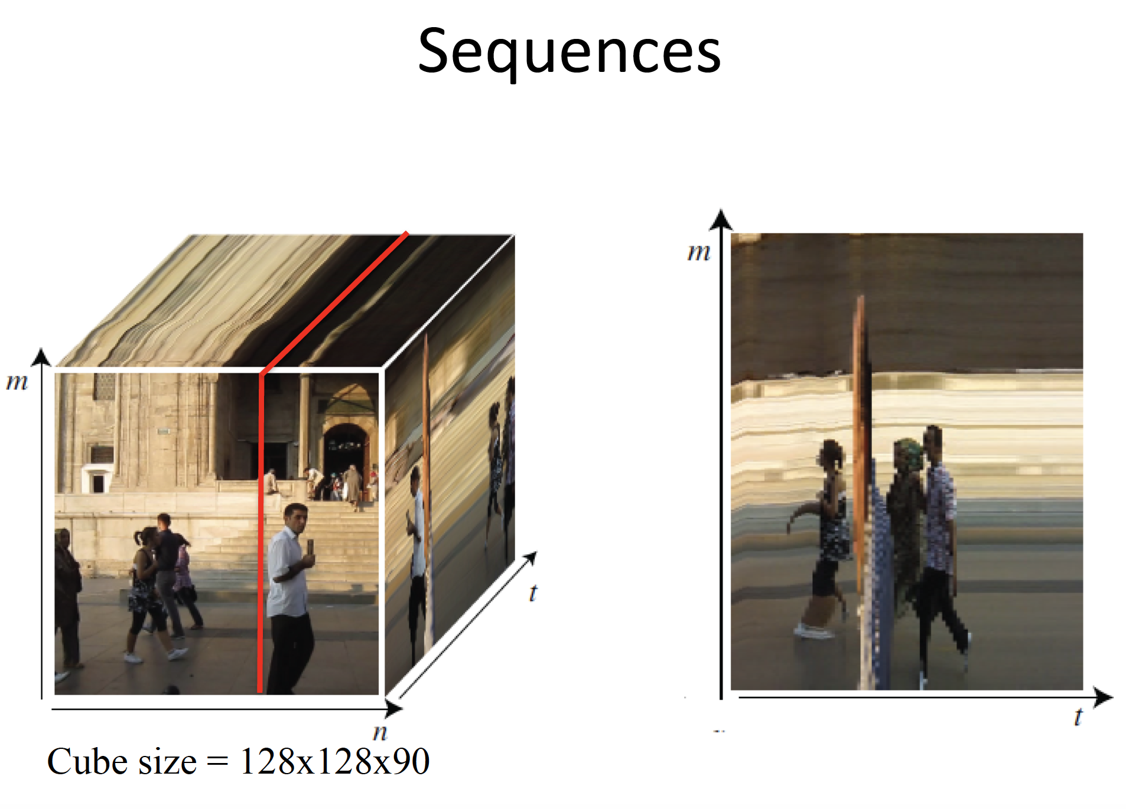

Slide 32


Slide 33


Slide 34


Slide 35


Slide 36


Slide 37


Slide 38


Slide 39


Slide 40


Slide 41


Slide 42


Slide 43


Slide 44


Slide 45


Slide 46


Slide 47
Take-home reading and next class
Multiscale pyramids
Lecturenotes: SignalProcessing.pdf
Linear filtering: page 111-120
http://szeliski.org/Book/drafts/SzeliskiBook_20100903_draft.pdf

